Slide 1

AgroChill Forecasting System: Optimizing the "Freezer Gambit“
AgroChill's "Freezer Gambit" strategy relies entirely on accurate price forecasts to determine whether to sell fresh produce immediately or store it for future sales. This presentation outlines our comprehensive data science solution, system architecture, and business insights to optimize profitability for perishable goods in weekly markets.

Slide 2




Data Science Problem & Approach
Understanding the problem
Identifying Data
Data pre-processing
Exploratory Data Analysis
Feature Engineering
Model Selection

Slide 3





Understanding the problem
Predicting weekly prices 1 to 4 weeks into future
Predicting weekly fresh prices for various fruits and vegetables across multiple geographical regions (economic centres) 1 to 4 weeks into the future.
Making rolling forecasts
Predictions generated at any point in time must utilize all available historical data up to that point. As new weekly data arrives, the forecast horizon should
roll forward accordingly.
Ingesting new data and automatic re-training with new data
Ingesting new data for weather and prices dynamically via a defined API and automatically retraining the predictive models periodically to adapt to new data
patterns and maintain forecast accuracy over time.
Resource constraints
Operating within resource constraints and delivering predictions with low latency.

Slide 4

Identifying Data
Weather Data:
Price Data:
Contained historical records presumably associated with weekly market cycles, including:
Date: The date of the record.
Region: The geographical economic centre.
Temperature (K): Temperature in Kelvin.
Rainfall (mm): Precipitation in millimetres.
Humidity (%): Relative humidity percentage.
Crop Yield Impact Score: A calculated metric indicating the favourability of environmental conditions for crop yield (higher score implies better conditions).
Contained historical price records, including:
Date: The date corresponding to the weather record.
Region: Matching the weather record region.
Commodity: The specific fruit or vegetable (Mapped from 'Crop' if necessary).
Price per Unit (Silver Drachma/kg): The target variable for prediction.
Type: Classification as 'Fruit' or 'Vegetable'.

Slide 5





Data pre-processing and cleaning
Loading data
Missing Value Check
Column Name Cleaning
Merging
Data Type Conversion
Sorting
Duplicate Handling

Slide 6

Exploratory Data Analysis(EDA)
EDA was performed on the pre-processed training dataset. Key findings include:
• Price Characteristics
1. Overall Distribution
2. Regional Variation
3. Type Variation
• Temporal Patterns
1. Individual price trends
2. Seasonality
• Weather Patterns and Correlation
1. Regional Weather Trends
2. Correlation Analysis
• Data Volume
1. Records per region

Slide 7
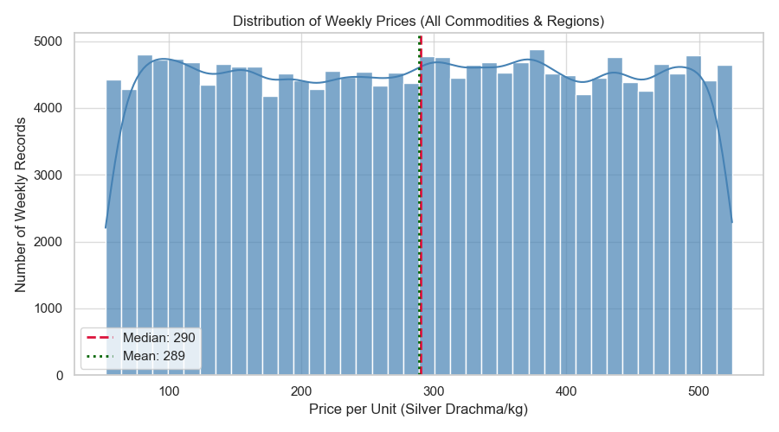
Exploratory Data Analysis(EDA) : Price Characteristics
Overall Distribution
Prices span a wide range (approx. 53 to 525 Silver Drachma/kg) with a distribution that is somewhat flat but slightly right skewed (Mean: ~289, Median: ~290). This wide spread and lack of a single strong peak suggests diverse pricing behaviors across commodities/regions and supports the use of non-linear models.

Slide 8
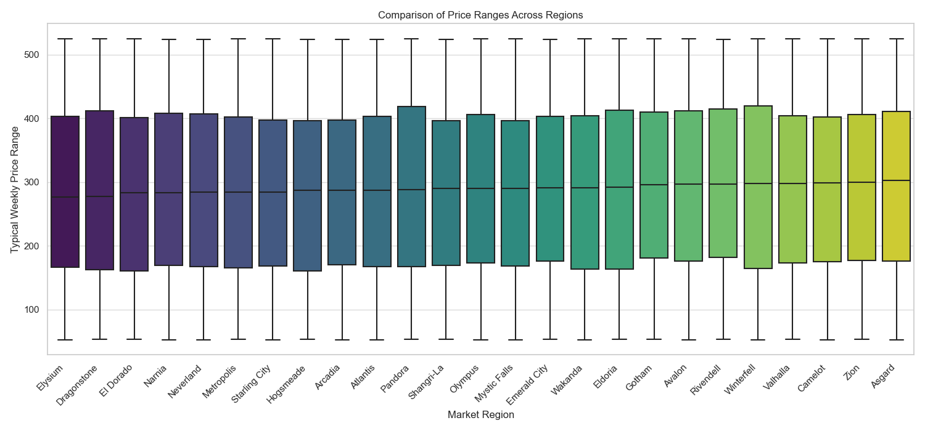
Exploratory Data Analysis(EDA) : Price Characteristics
Regional Variation
Box plots comparing regions show clear differences in median price levels (e.g., Elysium lowest at ~276, Asgard highest at ~303) and price variability (spread of the boxes). This confirms Region is a vital predictive feature.

Slide 9
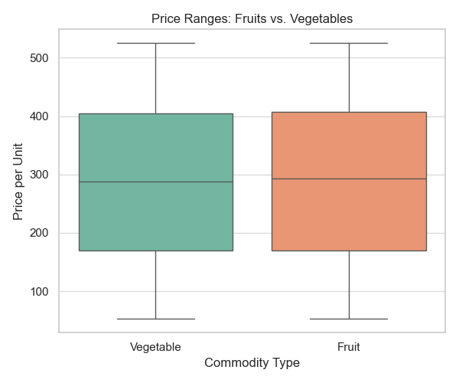
Exploratory Data Analysis(EDA) : Price Characteristics
Type Variation
The price distributions for Fruits (Median ~293) and Vegetables (Median ~288) are broadly similar in terms of central tendency and spread. This suggests that while Type might offer some information, the specific Commodity is likely a much stronger predictor.

Slide 10
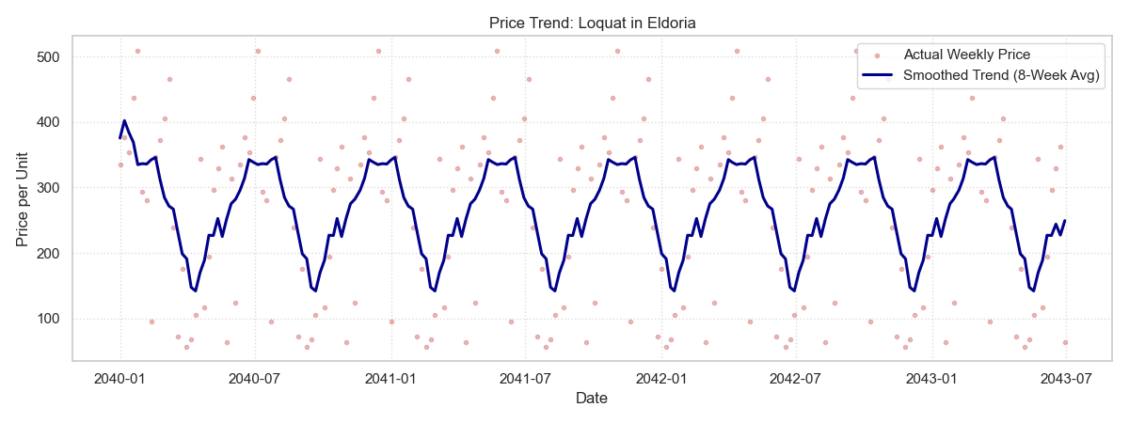
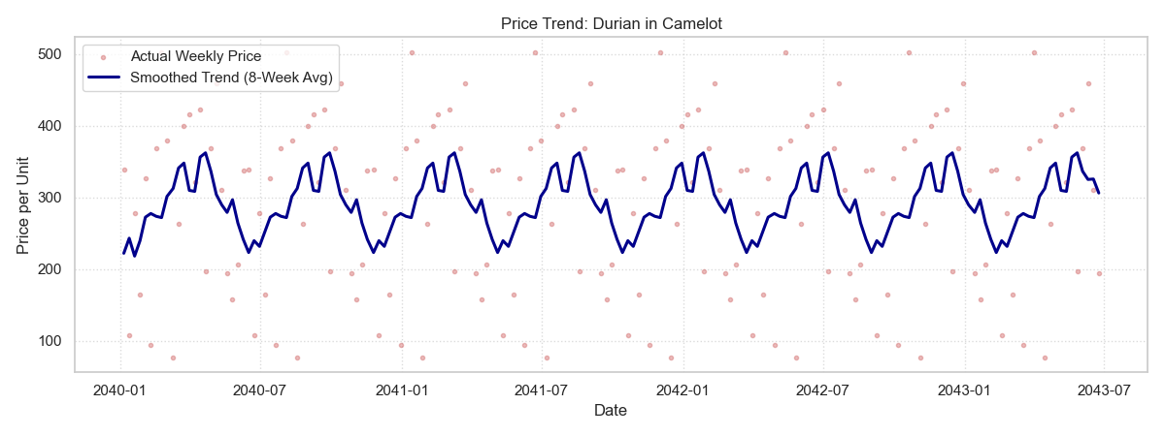
Exploratory Data Analysis(EDA) : Temporal Patterns
Individual Price Trends
Examining individual time series (e.g., Loquat in Eldoria, Durian in Camelot) reveals distinct patterns, volatility, and potential seasonality specific to each item/location. Smoothing these series with an 8 week rolling average highlights underlying trends and cyclical behavior
more clearly than the noisy weekly data. This strongly justifies a time-series approach with appropriate features

Slide 11
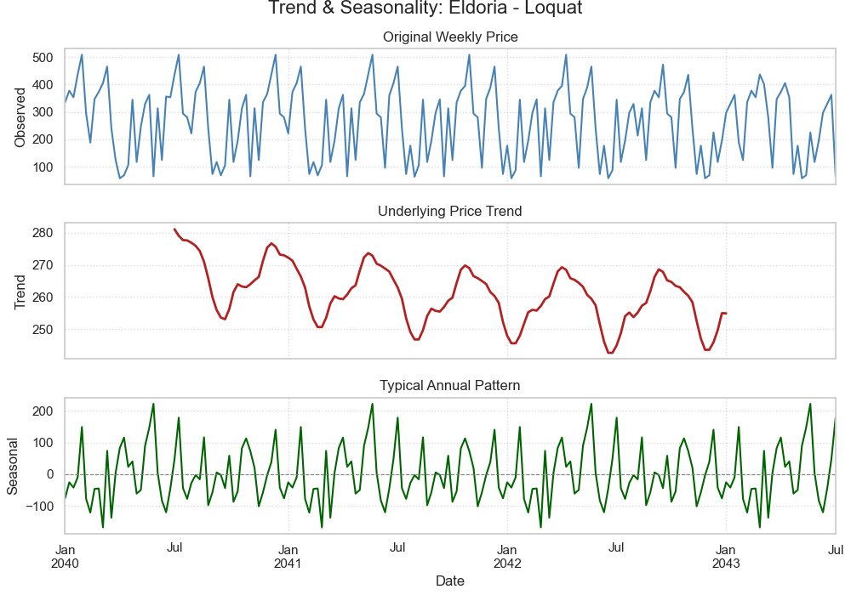
Exploratory Data Analysis(EDA) : Temporal Patterns
Seasonality
Seasonal decomposition of the 'Eldoria - Loquat' weekly price series clearly isolates a repeating annual pattern (Seasonal component) from the longer-term underlying trend. This confirms the presence of strong seasonality and necessitates features
like month or weekofyear to capture this predictable variation.

Slide 12
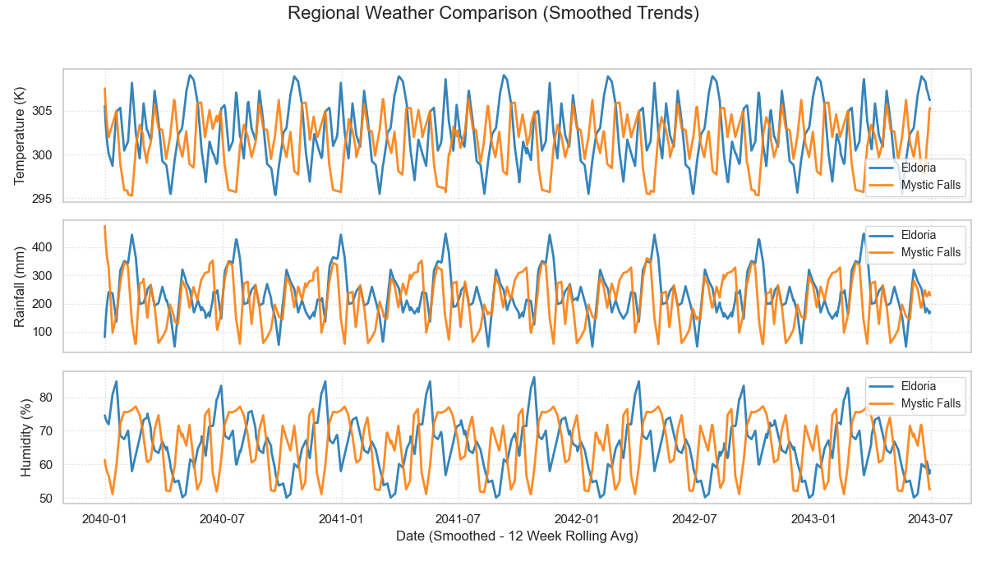
Exploratory Data Analysis(EDA) : Weather Patterns & Correlation
Regional Weather Trends
Comparing smoothed (12-week rolling average) weather patterns for representative regions like Eldoria and Mystic Falls shows distinct regional climates and clear seasonality, especially in temperature. Rainfall and humidity patterns also differ between regions. This provides context for why region is important and suggests weather features might interact with region.

Slide 13
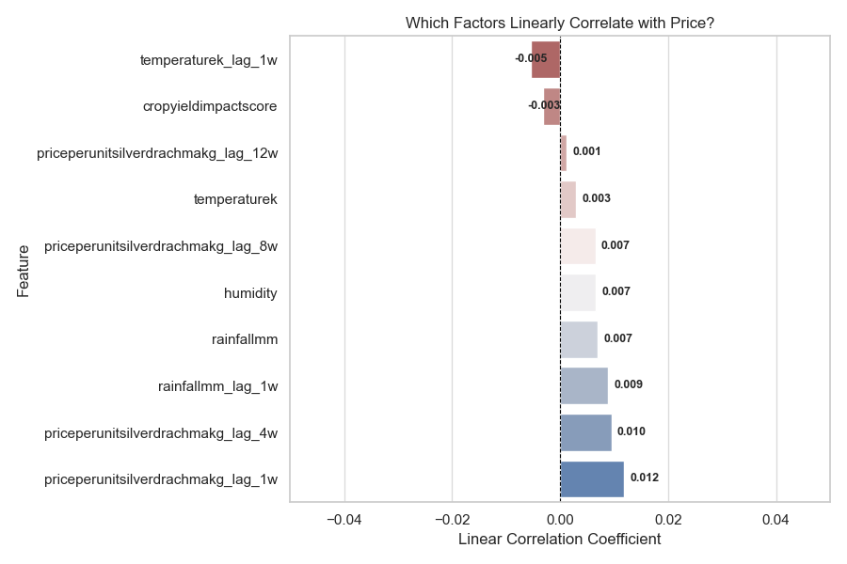
Exploratory Data Analysis(EDA) : Weather Patterns & Correlation
Correlation Analysis
A bar chart showing linear correlations with the current price reveals:
The strongest positive correlations are with recent price lags (price_lag_1w, price_lag_4w), confirming strong autocorrelation.
Correlations with weather variables (current and lagged temperaturek, rainfallmm, humidity) and cropyieldimpactscore are very weak (close to zero).

Slide 14
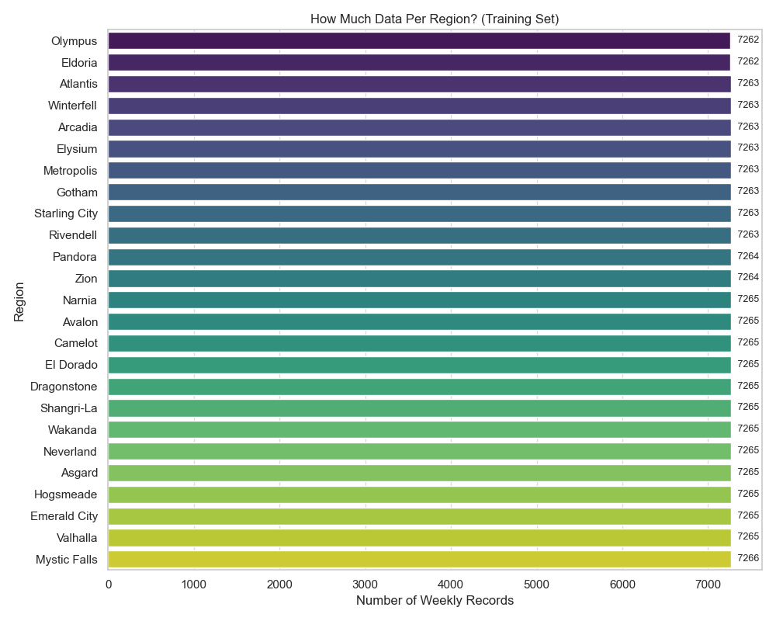
Exploratory Data Analysis(EDA) : Data Volume
Records per Region
The training data is remarkably well-balanced across regions, with each having a very similar number of records (approx. 72627266). This reduces concerns about model bias towards heavily represented regions.

Slide 15

Feature Engineering Strategy : Design Overview
Lag Features
Created for price and key weather indicators (1, 4, 8, 12 weeks prior) within each Region-Commodity group to capture autocorrelation and prevent data leakage.
Rolling Window Features
Calculated mean and standard deviation for price/weather variables over 4, 8, 12-week windows to capture trends and volatility.
Time-Based Features
Extracted year, month, week of year, day of week from the date to capture seasonality patterns essential for annual cycles.
Categorical Features
Region, Commodity, and Type were handled using One-Hot Encoding, with Region and Commodity proving to be important predictive features.

Slide 16
Model Selection & Performance
Given the time series nature, the need to capture non-linearities, and the strict resource constraints, Gradient Boosted Decision Trees (GBDTs) were identified as the most promising class of models. We systematically evaluated three leading GBDT
Implementations. The performance on the evaluation set was the primary criterion for final model selection.
Horizon | LightGBM (Eval RMSE) | XGBoost (Eval RMSE) | CatBoost (Eval RMSE) | Selected Model (Eval RMSE)
1w | 136.72 | 106.56 | 145.51 | XGBoost
2w | 126.87 | 120.65 | 151.22 | XGBoost
3w | 151.03 | 123.77 | 168.87 | XGBoost
4w | 161.95 | 139.79 | 162.44 | XGBoost
XGBoost models have consistently achieved significantly lower RMSE across all four prediction horizons. XGBoost demonstrated superior generalization performance for this specific dataset and feature set.

Slide 17





Model Selection & Performance
XGBoost Selected
Consistently achieved lowest RMSE across all horizons
Systematic Evaluation
Compared LightGBM, XGBoost, and CatBoost
Gradient Boosted Decision Trees
Best for capturing non-linear relationships

Slide 18

Data Pipeline Strategy
Data Ingestion
Processing & Feature Engineering
The aggregated dataset undergoes cleaning, merging, sorting, and the
full feature engineering process
API endpoints receive new data
Data Persistence
Tuning & Training
Hyperparameters are re-tuned (using Optuna), and new models(XGBoost)
are trained on the latest aggregated, featured data for each forecast horizon
Received data is stored persistently.
Triggering
Model Deployment (Hot Swap)
The newly trained models replace the existing models
currently loaded in the running API's memory
Retraining is initiated automatically on a schedule or
manually via an API call.
Aggregation
Prediction
The prediction endpoint dynamically uses the aggregated data to
generate features for the requested item's latest time point and
applies the currently loaded models
The retraining job loads both original training data and
all persisted incoming data

Slide 19
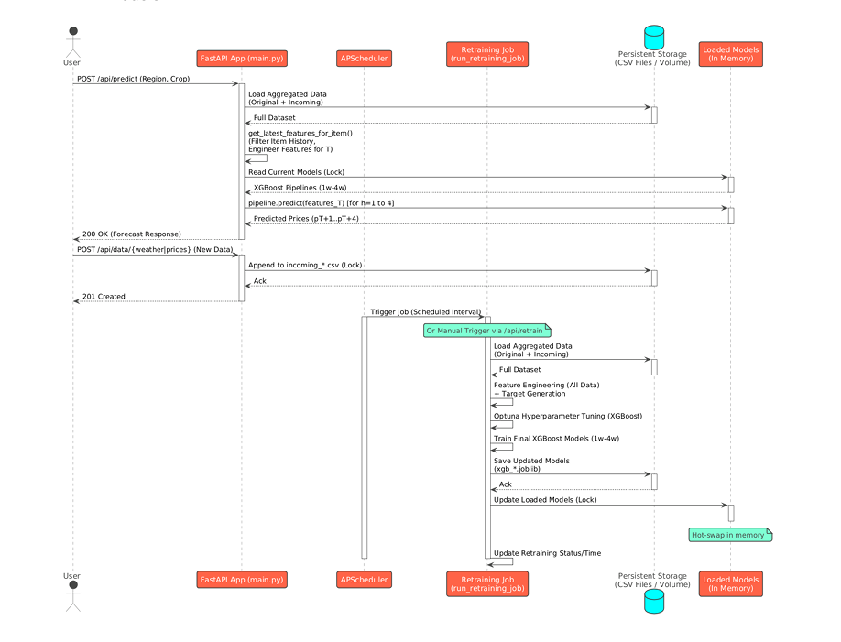
Data Pipeline Strategy

Slide 20



System Architecture
FastAPI Web Service
RESTful API interface running on Uvicorn ASGI server
XGBoost Models Pipeline
Four models for different forecast horizons
Automated Retraining
APScheduler background job for model updates
Our containerized web service provides key endpoints for predictions (/api/predict), data ingestion (/api/data/weather, /api/data/prices), system status (/api/status), and manual retraining (/api/retrain). The system dynamically loads historical data, generates features, and applies the appropriate models to deliver accurate forecasts.
For data persistence, we use simple CSV files with concurrency control via python-filelock, while scikit-learn Pipelines ensure consistent transformations between training and prediction.

Slide 21
Business Insights from Data Analysis
Regional Price Variation
Price Autocorrelation
Prices and volatility differ noticeably across regions, meaning the "best market" is not fixed. This highlights the importance of targeting specific regions based on predicted price advantages.
Recent prices are strong indicators of future prices. Tracking recent trends is crucial, and the model heavily relies on these lagged features, though sudden market shocks remain harder to forecast.
Seasonal Patterns
Weather-Price Relationship
Both prices and weather show clear annual cycles. Pricing strategies should anticipate seasonal highs and lows, which the model captures through time-based features.
Current weather has a weak linear correlation with current price. Weather's influence is likely more complex (non-linear, lagged supply effects), meaning direct weather reports aren't immediate price predictors.

Slide 22
Thank You
from
Team Fouette Bytes
Wansajee Illukkumbura(leader)
Sithum Konthasinghe
Sesandi Samarakoon

